Slide 1
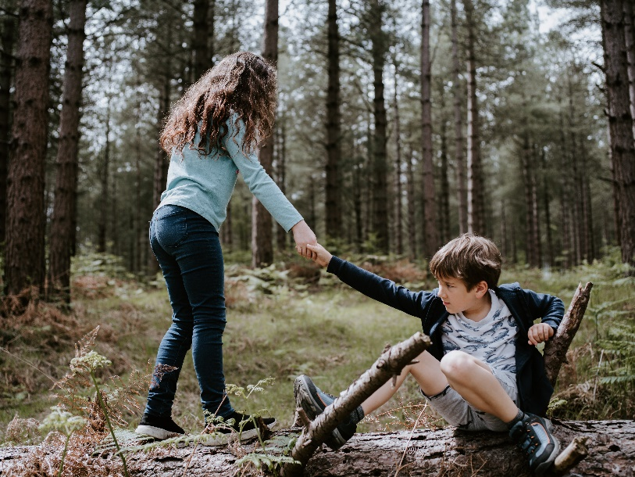
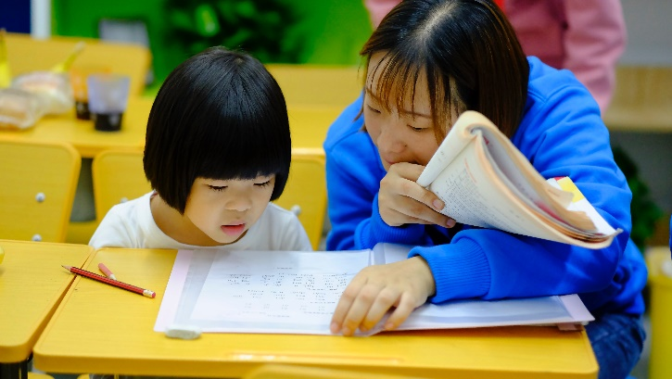
Sanmin Senior High school
Christopher bAUMAN

Slide 2
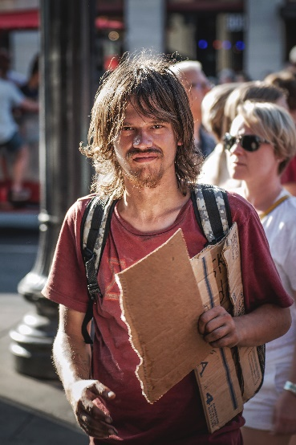
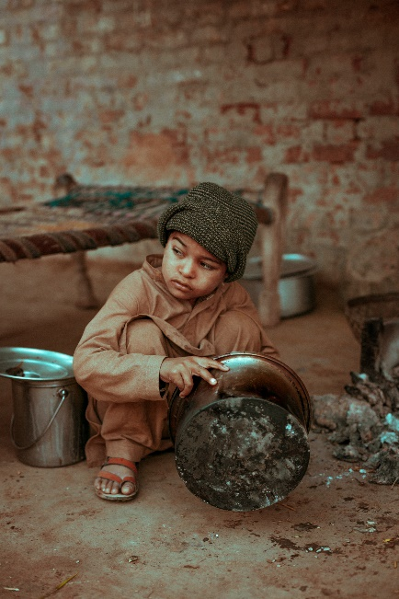
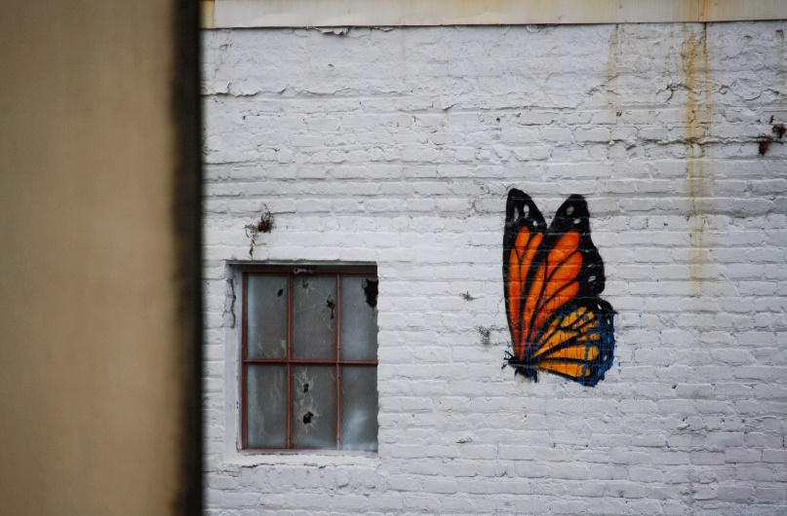
Education Infographic
Assistance
CPR
Selfie v photographer
Social media
Smile
Time
Money
Self sacrifice
Donate
Influence others
Break the cycle
Mentor
Who
Motivation
Think outside the box
Trash
Grass
drawing
Chris Bauman

